Slide 1
Sequence Diagrams

Slide 2
Interaction Diagrams
UML Specifies a number of interaction diagrams to model dynamic aspects of the system
Dynamic aspects of the system
Messages moving among objects/classes
Flow of control among objects
Sequences of events

Slide 3
Dynamic Diagram Types
Interaction Diagrams - Set of objects or roles and the messages that can be passed among them.
Sequence Diagrams - emphasize time ordering
Communication Diagrams - emphasize structural ordering
State Diagrams
State machine consisting of states, transitions, events and activities of an object
Activity & Swimlane Diagrams
Emphasize and show flow of control among objects

Slide 4
Sequence Diagrams
Describe the flow of messages, events, actions between objects
Show concurrent processes and activations
Show time sequences that are not easily depicted in other diagrams
Typically used during analysis and design to document and understand the logical flow of your system
Emphasis on time ordering!

Slide 5
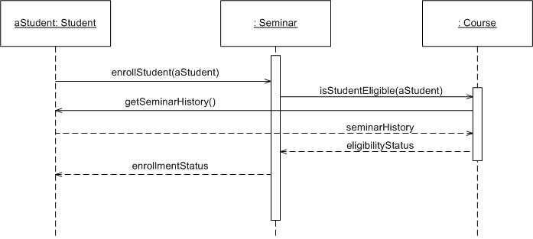
Sequence Diagram

Slide 6
Sequence Diagram
Time Increasing -->
All lines should be horizontal to indicate instantaneous actions. Additionally if ActivityA happens before ActivityB, ActivityA must be above activity A
Lower = Later!

Slide 7
Diagonal Lines
:Student
:Registration System
Time=A
GetDetails()
Time=B
What does this mean?
Do you typically care?

Slide 8
Components
Objects: aStudent is a specific instance of the Student class
Generic (unnamed) objects
Generic (unnamed) objects of class type Seminar
and Course
Specific
Instance of an
Object

Slide 9
Components
execution
lifeline

Slide 10
Components
Method call
Return value

Slide 11
Components
c : Client
o : ODBCProxy
create()
: Transaction
setActions(a, b, c)
setValues(a, 3, 4)
setValues(b, c, 7)
(committed)
destroy()
create()
destroy()
Synchronous message
Asynchronous message
Return message

Slide 12
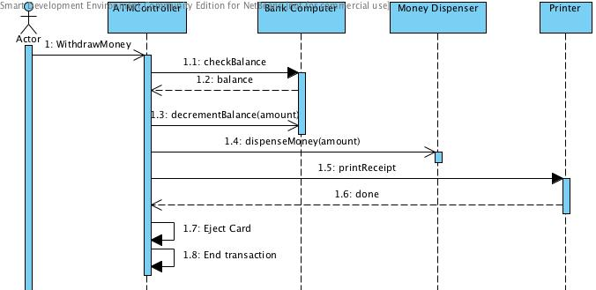
Async Message Example
There are problems here… what are they?
Synchronous message
Asynchronous message
Return message

Slide 13
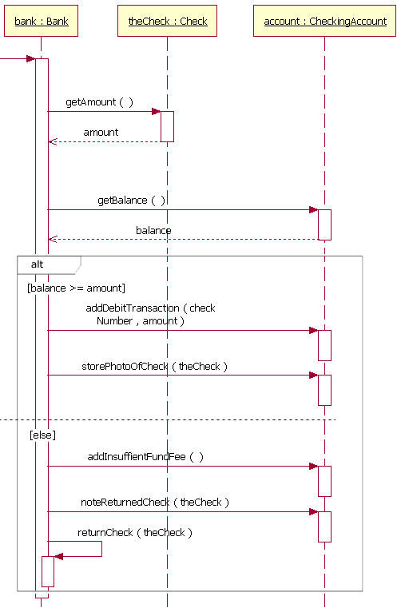
Components: alt/else

Slide 14
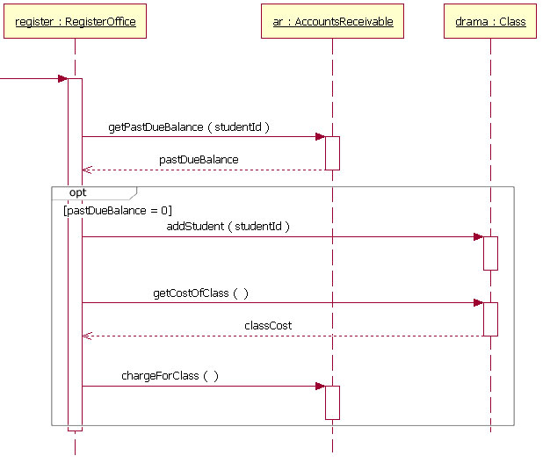
Components: option

Slide 15
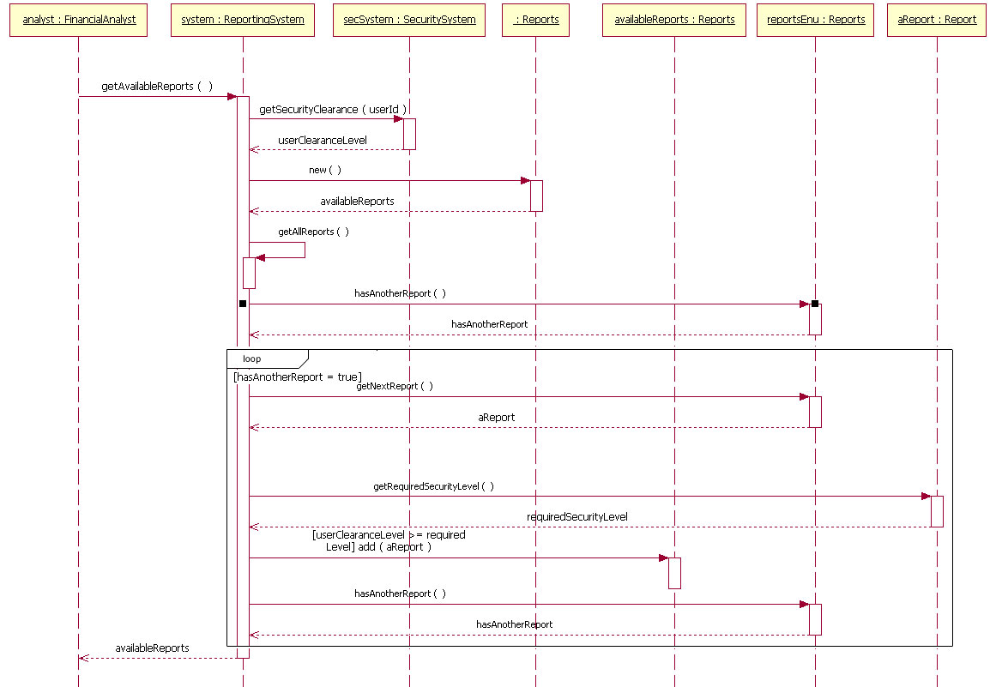
Components: loop

Slide 16
Rules of thumb
Rarely use options,loops,alt/else
These constructs complicate a diagram and make them hard to read/interpret.
Frequently it is better to create multiple simple diagrams
Create sequence diagrams for use cases when it helps clarify and visualize a complex flow
Remember: the goal of UML is communication and understanding

Slide 17
Summary
Sequence diagrams model object interactions with an emphasis on time ordering
Method call lines
Must be horizontal!
Vertical height matters! “Lower equals Later”
Label the lines
Lifeline – dotted vertical line
Execution bar – bar around lifeline when code is running
Arrows
Synchronous call (you’re waiting for a return value) – triangle arrow-head
Asynchronous call (not waiting for a return) – open arrow-head
Return call – dashed line

Slide 18
In class exercise
Draw a sequence diagram for:
Getting on a flight. Start at home, check in at the counter, go through security, and end up at the gate. (If you have time during the exercise, get yourself to your seat.)
You may get searched in security

Slide 19
In class exercise
Draw a sequence diagram for:
Getting money from an ATM machine
Treat each part of the ATM as a class
Money dispenser
Screen
Keypad
Bank computer
Etc…

